Slide 1
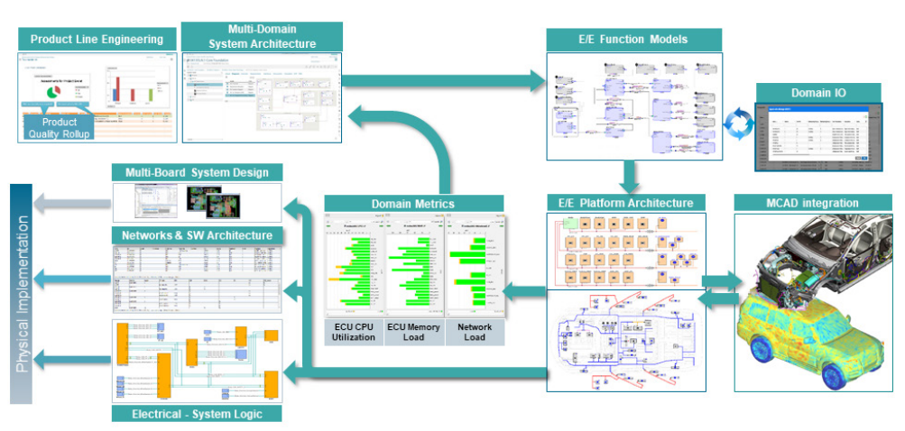

The CPSA® Advanced Level Module DDD
iSAQB® Training Course in Domain-Driven Design
For Volkswagen Group - India
22-Dec-2025 to 09-Jan-2026 (6 Days, 4 Hours/Day)

Slide 2

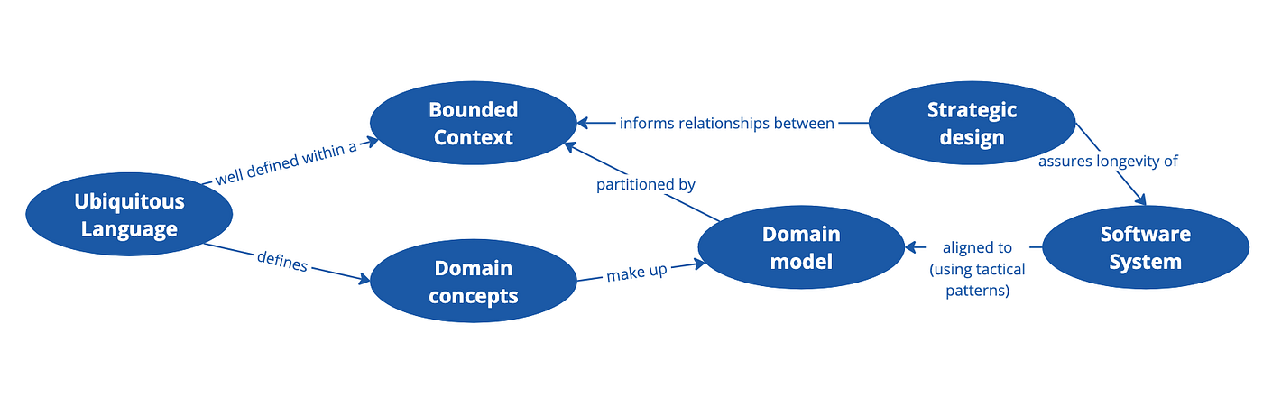


Course Overview: Domain-Driven Design
What is DDD?
A strategic approach to software design that focuses on complex business domains and creates a shared understanding between technical teams and domain experts.
Why for Automotive?
Modern vehicles contain 100+ million lines of code across multiple domains (infotainment, safety, powertrain), requiring precise modeling of complex interactions.
Value for Architecture
Creates precise, transparent, and transformable representations of domains, enabling better communication, reduced complexity, and more maintainable systems.

Slide 3




iSAQB Certification Pathway
Foundation Level
Advanced Level
Completed ✓
Current Focus
Provides fundamental knowledge of software architecture principles, methods, and techniques.
Specialized modules for in-depth knowledge in specific areas of software architecture.
Architecture Fundamentals
Quality Attributes
DDD (Current)
Cloud Architecture
Security
Design Patterns
Embedded Systems
And more...
Technical Competence
Methodical Competence
Communicative Competence
Total Credits
0
20
10
30

Slide 4






Training Schedule and Flow
6-Day Training Journey
4 hours per day • Building from foundations to strategic design
This training provides 24 hours of instruction, exceeding the recommended 17 hours for deeper dives, more exercises, and comprehensive coverage.
22-Dec-2025
05-Jan-2026
06-Jan-2026
07-Jan-2026
08-Jan-2026
Day 1
Day 2
Day 3
Day 4
Day 5
Foundations
Knowledge Crunching
Implementation
Architecture
Strategic Design 1
Domain, Model & Ubiquitous Language
From model to technical implementation
Model in application architecture
Cutting and distinguishing models
Collaborative modeling with domain experts
09-Jan-2026
Day 6
Strategic Design 2
Context Mapping
Foundations
Knowledge
Implementation
Architecture
Strategic

Slide 5







Day 1: Foundations - Domain, Model & Ubiquitous Language
1
22-Dec-2025
Foundations: Domain, Model & Ubiquitous Language
Learning Goals
Concepts Covered
Activities & Skills
LG 1-1
Domain & Domain Model
Activities
Explain connections between domains, software, and models
Software as representation of expert knowledge
• Define a simple domain and its boundaries
Ubiquitous Language
• Create a ubiquitous language for a given domain
LG 1-2
• Model basic domain concepts using class diagrams
Common terminology for experts and developers
Understand role of domain-specific terminology in building ubiquitous language
Building Blocks
Skills Being Built
LG 1-3
Entities, Value Objects, Aggregates, Services
DDD Foundations
Domain Modeling
Explain building blocks of DDD (Entities, Value Objects, Aggregates, etc.)
Technical Components
Communication
Technical Translation
Factories, Repositories, Domain Events
LG 1-4
Explain connections between building blocks

Slide 6




Day 2: Knowledge Crunching - The Path to the Model
2
05-Jan-2026
Knowledge Crunching: The Path to the Model
Learning Goals
Concepts Covered
Activities & Skills
LG 2-1 to 2-3
Agile & Evolutionary Modeling
Activities
Empower domain experts, select suitable contacts, communicate effectively
Iterative refinement of domain models
• Workshop-style collaborative modeling sessions
Domain Expert Empowerment
• Role-playing interviews with domain experts
LG 2-4 to 2-6
• Analyzing a domain through observation
Leveraging expert knowledge effectively
Skills Being Built
Use modeling techniques, conduct interviews, apply observation methods
Collaborative Modeling Methods
Communication
Collaboration
LG 2-7 to 2-9
EventStorming, Domain Storytelling, User Story Mapping
Domain Analysis
Workshop Facilitation
Overview of Collaborative Modeling, select approaches, conduct workshops
Knowledge Elicitation
Interviewing, observation, field observation, apprenticing
LG 2-10
Understand agility as foundation of DDD

Slide 7




Day 3: From Model to Implementation
3
06-Jan-2026
From Model to Implementation
Learning Goals
Concepts Covered
Activities & Skills
LG 3-1
Cohesion & Coupling
Activities
Extend domain model with technical building blocks (Repositories, Factories)
Principles for maintainable software design
• Refactoring domain model into technical components
SOLID Principles
• Designing interfaces and technical layers
LG 3-2
Single Responsibility, Open/Closed, Liskov Substitution
• Debating benefits of DDD for complex logic
Model interfaces for domain classes
Skills Being Built
LG 3-3
Dependency Management
Technical Implementation
Account for interactions between implementation and model
Avoiding cyclical dependencies, Law of Demeter
Technical Building Blocks
Design Principles
Refactoring
LG 3-4
Repositories, Factories, Aggregates
DDD Justification
Argue why DDD is worthwhile for complex business logic

Slide 8





Day 4: The Model in Application Architecture
4
07-Jan-2026
The Model in Application Architecture
Learning Goals
Concepts Covered
Activities & Skills
LG 4-1
Hexagonal Architecture
Activities
Design a ports & adapter architecture for the domain model
Ports & Adapters pattern for isolation
• Design hexagonal architecture for domain model
CQRS
• Compare and contrast DDD and BDD approaches
LG 4-2
• Map domain model to architectural layers
Command-Query Responsibility Segregation
Skills Being Built
Formulate correlations and distinctions between DDD and BDD
Layered Architecture
Architectural Design
Key Takeaway
Traditional architectural approach
Dependency Injection
System Integration
Pattern Application
Integrate domain model into larger system architecture effectively
Inversion of Control for loose coupling
DDD vs BDD

Slide 9




Day 5: Strategic Design 1 - Cutting and Distinguishing Models
5
08-Jan-2026
Strategic Design 1: Cutting and Distinguishing Models
Learning Goals
Concepts Covered
Activities & Skills
LG 5-1 to 5-2
Problem Space vs Solution Space
Activities
Identify symptoms of large models, assess cross-team models
Distinguishing domain problems from technical solutions
• Analyze large system and identify problems
• Define Bounded Contexts and relationships
LG 5-3
Subdomain Classification
• Create Context Map for complex system
Move from problem to solution space
Core, Supporting, Generic subdomains
Skills Being Built
LG 5-4
Bounded Context
Strategic Thinking
Distill the core of a system
Explicit boundaries for domain models
System Decomposition
LG 5-5
Context Map
Context Mapping
Architectural Vision
Describe Bounded Contexts in a Context Map
Visualizing relationships between contexts

Slide 10




Day 6: Strategic Design 2 - Context Mapping
6
09-Jan-2026
Strategic Design 2: Context Mapping
Learning Goals
Concepts Covered
Activities & Skills
LG 6-1 to 6-2
Customer/Supplier
Activities
Use interfaces for customer/supplier teams, design Open Host Service
Relationships between upstream and downstream contexts
• Design inter-context communication strategies
• Map system integrations using context patterns
LG 6-3 to 6-4
Open Host Service (OHS)
• Design Anticorruption Layer for external systems
Isolate model with Anticorruption Layer, reuse elements in Shared Kernel
Public API for multiple client contexts
Skills Being Built
Anticorruption Layer
Inter-context Design
LG 6-5
Translation layer between contexts
Integration Strategies
Understand when to divide models with Separate Ways
Domain Events
Communication Patterns
Asynchronous communication between contexts
LG 6-6
System Boundaries
Use Domain Events for communication between contexts

Slide 11


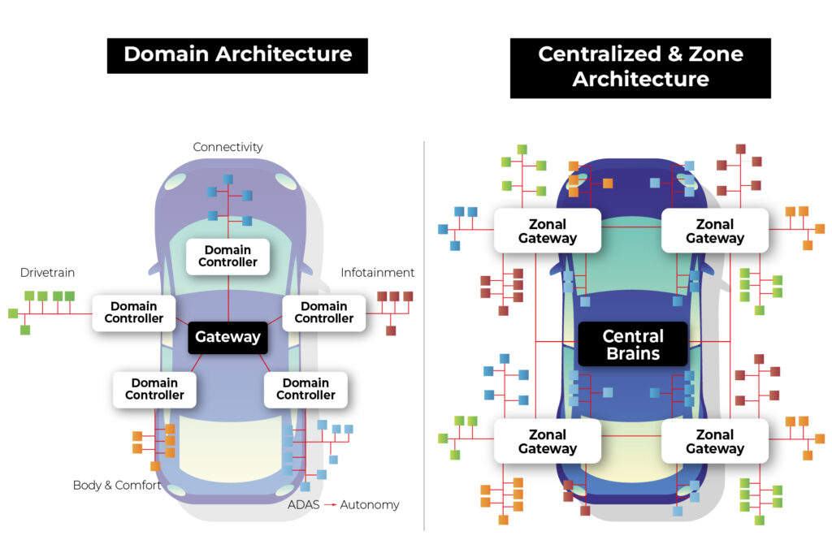










Connecting DDD to the Automotive Domain and Volkswagen Projects
Automotive Software Complexity
DDD Applications in Automotive
Applying to Volkswagen Projects
Bounded Contexts
Project Integration
Separate contexts for infotainment, powertrain, safety, connectivity
Apply DDD to your specific Volkswagen projects
Key Applications
Context Mapping
Infotainment Systems
Customer/Supplier relationships between safety and powertrain
EV Battery Management
Domain Events
Autonomous Driving
Event-driven communication between vehicle subsystems
Connected Services
Fleet Management
Growing Complexity
Modern vehicles contain 100+ million lines of code across multiple domains
Ubiquitous Language
Common terminology for engineers, developers, and domain experts
"DDD helps Volkswagen teams create clear boundaries between vehicle subsystems while ensuring effective communication between them."
Multiple Domains
Infotainment, powertrain, safety, connectivity, autonomous driving
Cross-team Collaboration
Different teams work on different vehicle subsystems
Benefits
Reduced complexity, better maintainability, improved collaboration between teams

Slide 12












End Outcomes & Next Steps
Skills Acquired
Value for Volkswagen Projects
Next Steps
Strategic Design
Automotive Software Excellence
Decompose complex systems into manageable contexts
Design complex vehicle systems with clear boundaries
Apply Knowledge
Implement DDD concepts in your current Volkswagen projects
Tactical Implementation
Faster Development
Translate domain models into technical solutions
Reduce integration complexity between vehicle subsystems
Collaboration
Bridge communication between domain experts and developers
Better Decision Making
Share Learnings
Strategic approach to system architecture decisions
Mentor colleagues and establish DDD practices in teams
Domain Modeling
Context Mapping
Cross-Team Collaboration
Event-Driven Design
Effective communication between specialized teams
Continue Learning
Hexagonal Architecture
Explore advanced DDD patterns and automotive case studies
Pursue CPSA-A Certification Exam

